Slide 1
Case Study Solution
Random Ltd

Slide 2
Motivation
One of the main concern of organizations is to maintain a healthy cash flow. Maintaining a strong accounts receivable process is a vital need for any organization to keep it’s cash flow healthier as effective management of AR and overall financial performance of an organization are positively correlated.
Random Ltd is a CPG company selling their products across the globe to various distributors/retailers
These distributors/retailers are invoiced and their payments must be cleared within agreed timeline
Random Ltd’s Finance & Accounting department has realized that some of these distributors/retailers are not obliging with the defined payments terms and make their payment late.
In order to address this concern affecting financial health of the company, CFO of Random Ltd has decided to seek a solution from Data science team.
Post several rounds of discussions over what data to be collected (as per availability) and what needs to be predicted to build a decision support system. Following is the outcome:
1. Based on availability, 2 datasets are shared:
a. Invoice dataset – containing details of invoice generated along with due date and payment date if invoice is paid at customer level
b. PO dataset – containing purchase orders created at customer level with an encoding for type of PO

Slide 3
Deliverables
Following are the key deliverables asked by Finance & Accounts department:
1. Provide key insights in understanding the current state of random Ltd’s cash flow with help of descriptive statistics and data visualization.
2. Provide deeper insights into payment behaviour of 3 classes of customers identified based on their payment status:
a. In time payment behaviour
b. In month payment behaviour
c. Delayed over month behaviour
3. Develop a prediction model to predict payment behaviour of these 3 classes with available data to help in coming up with an automated decision support system for AR collection process
4. Provide information of model evaluation criterion and help them to understand what other features could further improved model performance, if provided.
5. Finally, based on observations from above said deliverables, devise a strategy to improve health of cash flow.

Slide 4
Descriptive and Visual Analysis Results

Slide 5
Insights Gathered From Class Distribution
Post data pre-processing, the very first thing is to look at class distribution to make sure if all classes in data are equally distributed or we are dealing with imbalance in class distribution. Distribution of 3 classes looks like:
Distribution of Invoice samples which got paid within time or within month are close to each other
As our primary class of interest is predict customers who are going to fall under ‘Delayed over month behaviour’ class and we just have 15.07% of samples under this class. We are going to deal with an imbalanced class distribution as model now has fewer samples to learn targeted behaviour affecting cash flow negatively.
We will take care of this imbalance situation during model development!
Category Label | Class | Code | Num of Samples | Distribution
invoice_paid_in time | In time payment behavior | 0 | 166391 | 39.56%
invoice_paid_in_same_month | In month payment behavior | 1 | 190803 | 45.37%
invoice_paid_over_month_or_not_paid | Delayed over month behavior | 2 | 63400 | 15.07%

Slide 6
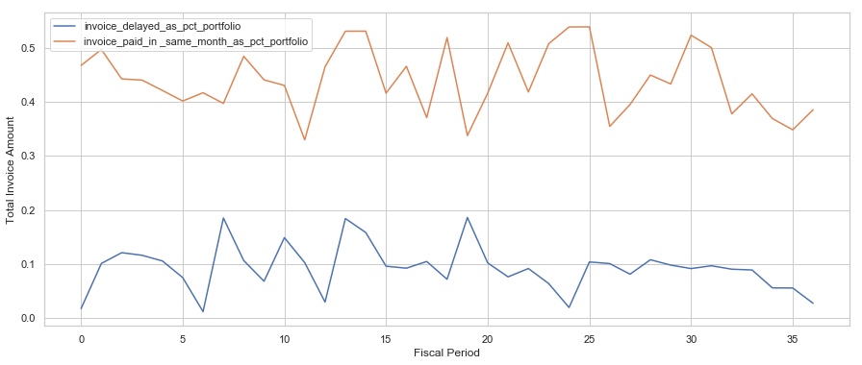
Effect of Delayed Invoices On Cash Flow
Invoices delayed over a month tend to vary by fiscal period in range of 5-20% of entire portfolio amount with an average of 9.29% across entire period with standard deviation of 4.3%.
Invoices paid within same month tend to vary between 32% - 56% of entire portfolio amount with an average of 44.03% with standard deviation of 6%.
Invoices delayed over month got delayed by an average of ~39 days and invoice paid within same month delayed by an average of ~5 days.
This means that on an average 10% on entire invoice amount is at risk of either getting delayed by over a month after due date or lost from recovering. This is affecting the cash flow negatively.

Slide 7
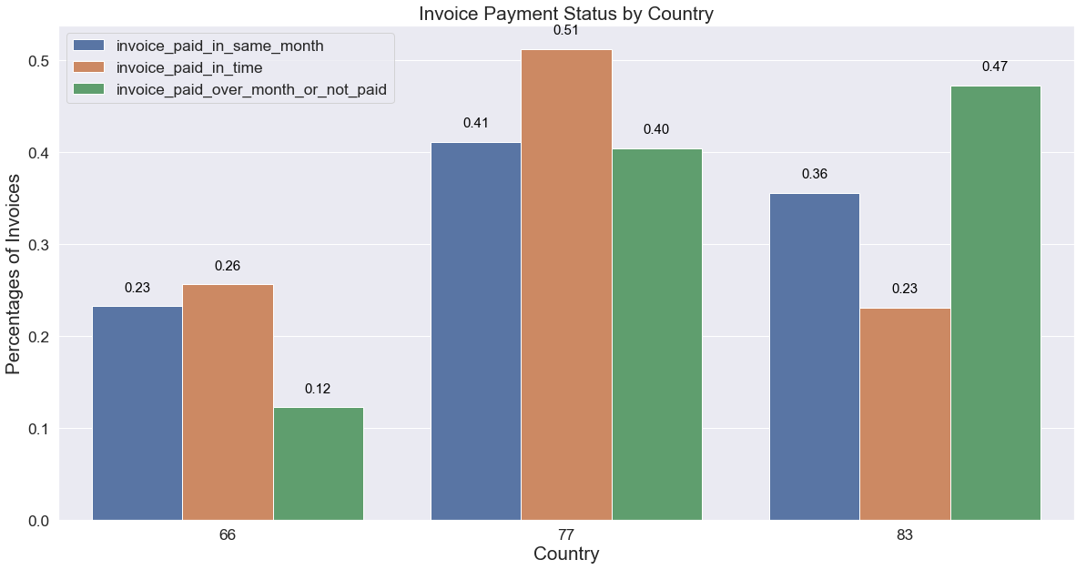
Class distribution across countries
Country with ID 83 is having 47% (approx 30k) of total invoices falling under the class “Delayed over month behaviour” which means that distributors/retailers in this country do not oblige with payment terms and tend to make payments late and are affecting cash flow negatively.
Country with ID 77 is having 51% (approx. 85k) of all invoices falling under class “In time payment behaviour” means that most of retailers/distributors in this country do honour their payment terms and positively affecting the cash flow.
Country with ID 66 is having least number of invoices (22.55%) among 3 countries but having only 12% of total invoices paid over month delay and is having not much of negative effect on cash flow.

Slide 8
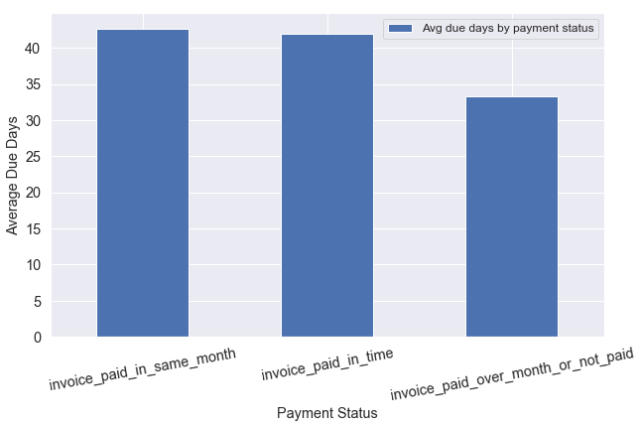
Insights Gathered From Invoice Due Days
Here our assumption is that invoices with fewer days between invoice generation and due date tend to be paid later.
Here we refer to invoice due days as number of days available to customer for making payment after invoice being generated.
Bar chart shows that average number of due days are not consistent across all 3 classes.
All invoices either paid within due date or paid in same month are having higher average number of days as compared to invoices delayed over month.
One of the plausible reason for this could be that Random Ltd has a stringent policy of giving strict timelines (less number of days) for small distributors/retailers in making their payments due to their higher riskiness and least bargaining power in negotiating for payment terms. We can further investigate to support this reasoning by looking at invoice amount.
Our assumption holds true!
Payment Status | Average Due Days
invoice_paid_in time | 41.98
invoice_paid_in_same_month | 42.72
invoice_paid_over_month_or_not_paid | 33.33

Slide 9
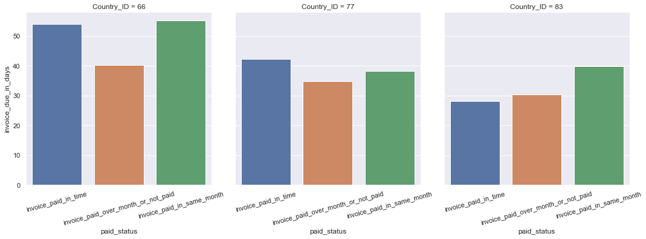
Average due days by payment status across countries
To investigate further based on average due days, we have looked as if the trend seen earlier is consistent across all 3 countries.
Country with ID 66 is having an average of more than 53 days in due days allowed for customer under invoices paid within due date or invoices paid in same month. No wonder why it has only 12% of total invoices delayed over a month.
Country with ID 77 is consistent with overall trend seen earlier with higher number average due days against invoices paid in time (~42 days) and least average number of due days against invoices delayed over month (~35 days).
Country with ID 83 has the least average number of due days of ~30 days against invoices delayed over month clearly indicates why this country has 47% of the total invoices delayed over a month or not paid and a low 23% of total invoices paid within due date.
Comparing all 3 countries together, it is clear that customers in countries with ID 77 and 83 are less privileged in getting large number of days in paying their invoices and resulting to that both countries are contributing to 87% of total invoices delayed over month impact cash flow negatively.
Country_ID | Payment Status | Avg Invoice Due Days
66 | Invoice_paid_in_same_month | 55.06
66 | Invoice_paid_in_time | 53.91
66 | invoice_paid_over_month_or_not_paid | 40.31
77 | Invoice_paid_in_same_month | 38.16
77 | Invoice_paid_in_time | 42.28
77 | invoice_paid_over_month_or_not_paid | 34.76
83 | Invoice_paid_in_same_month | 39.91
83 | Invoice_paid_in_time | 28.07
83 | invoice_paid_over_month_or_not_paid | 30.29

Slide 10
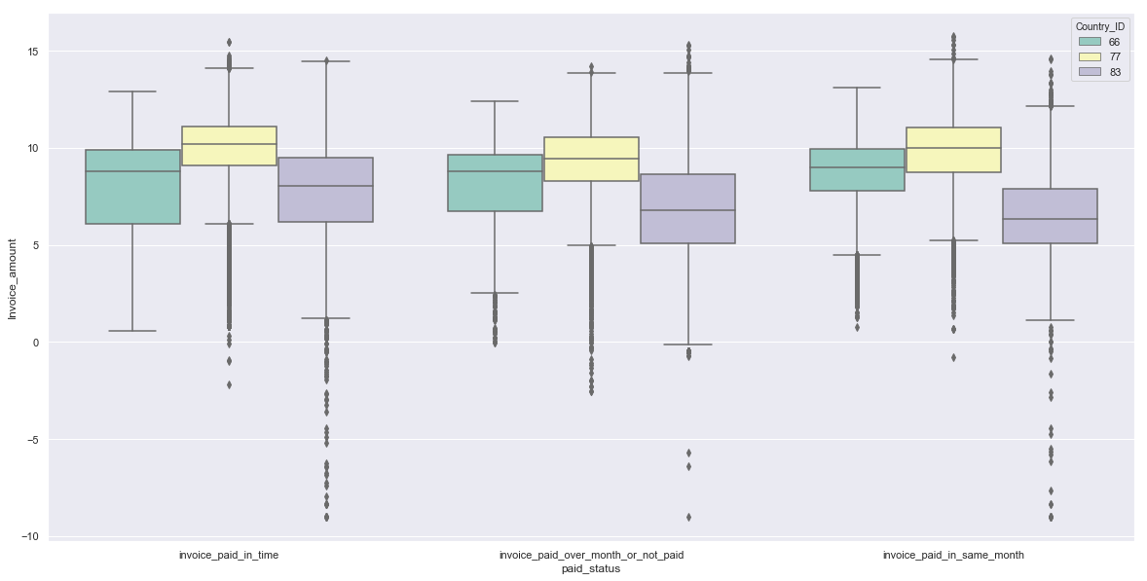
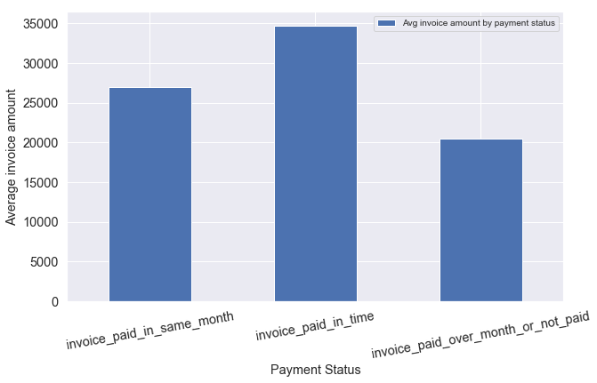
Insights Gathered From Invoice Amount
Here our assumption is that invoices with smaller amount tend to be delayed in making payments comparing to large amount invoices.
Invoice samples provided in data has a very large range from a minimum of $0.00011 to $6806902
Average invoice amount over all samples is $29040 and 50% of the invoice amounts lie below $7936 and 75% lie below $30635
Boxplot created taking log of invoice amount shows that there are a lot outliers amounts on min and max side lying out of IQR
Box plot is giving a hint of the fact that invoices with smaller amounts tend to be paid late (since log of invoice amount is used, it is less evident).
The below bar chart confirm our suspicion as it shows clearly that invoices delayed over a month or not paid are having least average amount ($20447)
The most apparent reason goes with the fact that most of these small amount invoices are issued for small size distributors/retailer with tight deadlines in making their payment (as seen earlier) causing delay and affecting cash flow negatively
Our assumption holds true!

Slide 11
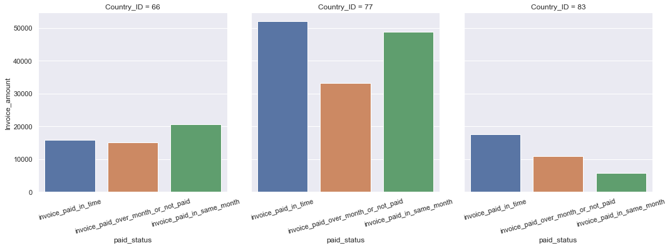
Average invoice amount by payment status across countries
Country with ID 77 is showing a clear distinction keeping up with trend seen on pervious slide. Average invoice amount for invoices delayed over a month or not paid is $33231 which is 32-36% lower than invoices paid within due date or within same month.
Countries with ID 66 and 83 are also more or less keeping up with the same trend but distinction is not much clear.
Invoices got delayed over a month or not paid are having the least average invoice amount in Country ID 83 ($10892) which also has the highest concentration of such invoices (47%) as seen earlier. This supports our belief that this country is having a large number of small distributors/retailers making delay in paying their invoice due to stringent payment terms.
Our major concern should be around country ID 77 with highest average invoice amount $33231. We have see that this country contributes to 40% of invoices (approx. 24k) delayed over a month or not paid. With such higher average invoice amount (3 times comparing to 83), it seems more riskier.
Country_ID | Payment Status | Avg Invoice Due Days
66 | Invoice_paid_in_same_month | 20530
66 | Invoice_paid_in_time | 15763
66 | invoice_paid_over_month_or_not_paid | 15142
77 | Invoice_paid_in_same_month | 48875
77 | Invoice_paid_in_time | 51938
77 | invoice_paid_over_month_or_not_paid | 33231
83 | Invoice_paid_in_same_month | 5768
83 | Invoice_paid_in_time | 17612
83 | invoice_paid_over_month_or_not_paid | 10892

Slide 12
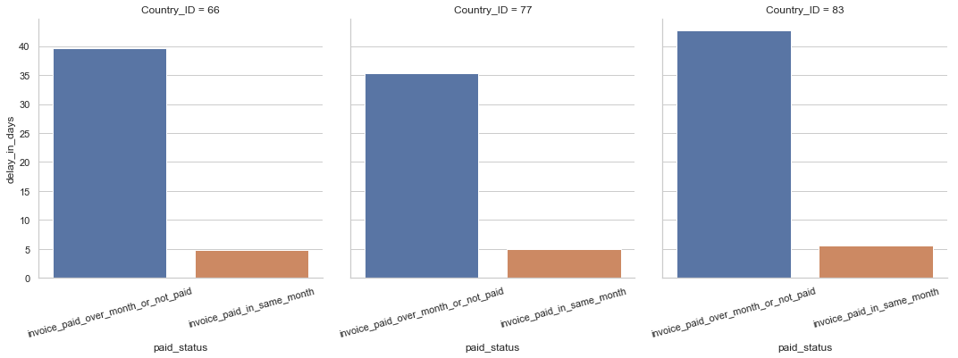
Insights Gathered From Payment Delay in Days
All 3 countries are showing that invoices which got paid within month are paid on average with a delay close to 5 days from due date.
Invoices which got delayed over a month or not paid got paid on average within 35 to 43 days after due date (if got paid).
Customers in country ID 83 are paying their invoices with highest average delay compared to other 2 countries which supports our belief that these are small size distributors/retailers with aggressive due date timeline to pay their invoices (~29 days on average) causing them higher delay in making payment.
Country_ID | Payment_Status | Average payment delay (in days)
66 | Invoice_paid_in_same_month | 4.84
66 | invoice_paid_over_month_or_not_paid | 39.71
77 | Invoice_paid_in_same_month | 5
77 | invoice_paid_over_month_or_not_paid | 35.26
83 | Invoice_paid_in_same_month | 5.6
83 | invoice_paid_over_month_or_not_paid | 42.67

Slide 13
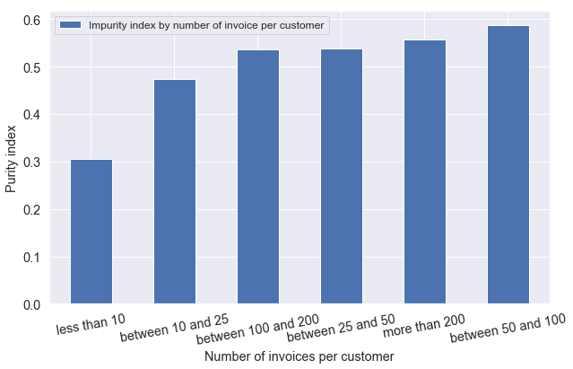
Insights Gathered From Impurity Index
Impurity index is calculated based on formula
(num of invoices delayed over month +
num of invoices paid with same month)/
total num of invoices
It ranges from 0 to 1
A value close to 0 means customer is ideal and paying invoices within due date and a value close to 1 means customer is paying all of it’s invoices after due date.
Based on plot, we can infer that customers with less number of invoices are more inclined to pay there invoices within due date while customers with number of invoices > 25 pay more than half of their invoices after due date.
Number of invoices per customer | Impurity Index
Less than 10 | 0.3051
Between 10 to 25 | 0.4741
Between 25 to 50 | 0.5372
Between 50 to 100 | 0.5877
Between 100 to 200 | 0.5360
More than 200 | 0.5571

Slide 14
Key Takeaways
A riskiness score is computed for all 3 countries for both ‘invoice delayed over month’ and ‘invoice paid in same month’ as:
Invoice delayed over month
Invoice paid within same month
In both case of delay in payment ‘invoice delayed over month’ & ‘Invoice paid within same month’, country with ID 77 is high in riskiness. Factors responsible for this is higher number of such invoices (40% & 41%) and high average invoice amount ($33231 & $48875)
Country ID | Pct of invoices | Number of invoices | Invoice amount (normalized) | Delay in payment (normalized) | Col 2 * Col3 * Col 4 * Col 5 | Average invoice amount | Riskiness
66 | 0.12 | 53061 | 0.740548736 | 1.004706001 | 4820 | 20447 | 0.24
77 | 0.4 | 53061 | 1.625226195 | 0.892116183 | 31004 | 20447 | 1.52
83 | 0.47 | 53061 | 0.532694283 | 1.079597207 | 14492 | 20447 | 0.71
Country ID | Pct of invoices | Number of invoices | Invoice amount (normalized) | Delay in payment (normalized) | Col 2 * Col3 * Col 4 * Col 5 | Avg invoice amount | Riskiness
66 | 0.23 | 190803 | 0.762261909 | 0.934362934 | 31256 | 26932 | 1.16
77 | 0.41 | 190803 | 1.814688301 | 0.965250965 | 137029 | 26932 | 5.09
83 | 0.36 | 190803 | 0.214161066 | 1.081081081 | 15903 | 26932 | 0.59

Slide 15
Continued...
Based on descriptive and visual analysis on data, the major factors affecting payment behaviour as per available data are:
1. Invoice amount – small invoice amount tend to be paid late
2. Invoice due days – invoices with less number of due days are generally paid late
3. Customer’s past practices in payment – As captured in impurity index
4. Number of invoices – customers with less number of invoices tend to pay within due date
5. Geographical variations
Due to limitation of data availability, we could only capture a handful of factors affecting payment
behaviour of customers.
A detailed list of other possible factors that could be captured using internal or external data sources is
Provided in later slides.

Slide 16
Model Development & Related Considerations

Slide 17
Approach
As per instructions provided, invoice payment behaviour is going to identified into 3 categories:
- In time payment behaviour
- In month payment behaviour
- Delayed over month behaviour
So this problem falls in the realm of multiclass classification with 3 classes to be predicted based on input features.
There are 2 available datasets containing raw features containing:
- Details at invoice level (Invoice_Serial, Invoice_Billing_ID, Customer_ID, Fiscal_Period, Country_ID, Invoice_Creation_Date, Invoice_Due_date, Invoice_Clearing_Date and Invoice_Amount)
- Details at PO level (Dispute_ID, Fiscal_Period, PO_Type, PO_Created_Date, PO_Modified_Date, PO_Delivery_Date, PO_Amount, Customer_ID, Country_ID)
Model development steps considered:
Data pre-processing
- Import required libraries in python
- Import datasets into python environment
- Handling missing values
- Handling date & time formats
- Perform feature engineering to generate features from raw data
- Encoding categorical feature
- Splitting dataset into train & test sets
- Normalization or scaling if necessary
Model Development
- Model fitting on training set
- Model Evaluation on test set based on appropriate metrics
- Model performance evaluation on validation set
Note: Programming details of applicable pre-processing steps as listed above is available in jupyter notebook

Slide 18
Features Extracted
Feature Engineering is performed over raw inputs available in datasets. Following features are calculated:
Impurity_index1 – Total number of invoices paid later than due date/Total number of invoices
Impurity_index2 – Total number of invoices delayed over month/Total number of invoices
Avg_delay_in_days – Average number of days customer has paid invoices after due days in past
Avg_invoice_amount – Average invoice amount of all invoices created in past
Cnt_invoice_paid_in_same_month – Total number of invoices paid in same month by customer in past
Cnt_invoice_paid_over_month_or_not_paid - Total number of invoices delayed over month by customer in past
Cnt_invoice_paid_in_time - Total number of invoices paid within due date by customer in past
Avg_invoice_paid_in_days – Average number of days in which customer paid invoices in past
Avg_due_in_days – Average number of days customer has got to pay invoices in past
Dispute_PO_amt – Total amount of PO under dispute
Cnt_dispute_PO – Total number of PO under dispute
Rec_average_invoice_amt – Average invoice amount in last 5 invoices created
Rec_pct_paid_invoices_in_time – number of invoices paid in time out of last 5 recent invoices
Rec_average_delay_in_days – average number of days payment delayed over last 5 invoices
Rec_average_invoice_paid_in_days – average number of days last 5 invoices being paid by customer
Cnt_invoices – total number of invoices against customer account binned into less than 10, between 10 to 25, between 25 to 50, between 50 to 100, between 100 to 200 and more than 200
Country_ID as dummy variable using 1-hot encoding
Note: All aggregation features are calculated at customer level and merged with invoice data. Reason being that
Objective of this model is to model behaviour which is a factor of customer discretion. We cannot calculate
Behaviour of invoice but behaviour of customer who pays invoice.

Slide 19
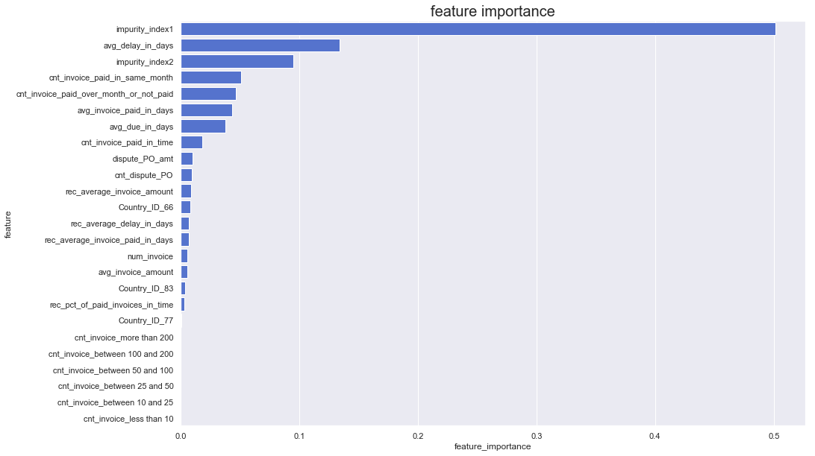
Assessing Features Importance
Relative importance of extracted features is assesses using Random Forest model fit.
The plot on left shows prominent/redundant variable to help with feature selection and avoid noisy features from getting into model.
Prominent feature found to be impurity_index1 and impurity_index2 along with few variables indicating count of invoices and average of invoice paid time in days, due time offered to customer, delay time in paying earlier invoices and recent average invoice amount.
Variables related to number of invoice break-up and Country ID are found insignificant.

Slide 20
Model Development
As per instructions, invoice with due date up to 2019-01-31 are considered for model development and date post that is considered as hold out set for future performance evaluation.
Since invoice data is sequential in nature, strategy adopted for train/test split is based on time factor and not random split. Invoices with due date up to ‘2018-08-31’ is considered for training the model and rest is considered as test set.
Since the problem falls under realm of multiclass classification. Not all algorithms can support it directly. We have considered 3 prominent algorithms: Random Forest, XGBoost and Deep Neural Network with 3 hidden layers.
Accuracy and Recall rate of class ‘Delayed over month behaviour’ coded under target variable as 2 are used as primary metrics for evaluation selection of model.
Primary reason of using these 2 evaluation metrics are:
- Both the metrics are meant for classification models
- Accuracy is giving an indication of overall model performance in correctness of class assignment by the algorithm
- Recall rate for class of interest “Delayed over month” coded as 2 is used for model selection as this class is to identify all those invoices expected to be delayed by large number of days (~35 – 42 days as seen during exploration of data. There this class has a severe negative impact on cash flow and model must be able to do well in identifying samples belongs to this class correctly in test data as much as possible (assuming there are no intervention actions are taken as a measure to remind customers to pay their outstanding invoices at this stage)
In order to find optimal hyper parameters, grid search is implemented with a cross validation of 5 folds over Random Forest model

Slide 21
Model Evaluation
Model Name | Training Accuracy | Test Accuracy | Recall Rate – 0 | Recall Rate – 1 | Recall Rate – 2
Random Forest | 62.25% | 58.46% | 0.66 | 0.51 | 0.57
XGBoost | 68.74% | 64.45% | 0.64 | 0.74 | 0.27
DNN | 61.95% | 54.83% | 0.57 | 0.31 | 0.57
Based on above 3 model results, we can infer,
- Random Forest is giving an accuracy on test set of 58.46% and recall rate on class 2 (delayed over month) of 0.57 (57% of samples are correctly identified and 43% are incorrectly assigned into other 2 classes)
- XGBoost is giving highest test accuracy among all 3 models, 64.45% but the least 0.27. This means that model is doing a poor job in correctly identifying samples from class 2.
- Deep neural network classifier is giving the least test accuracy, 51.26% but highest recall rate of 0.58. Also to notice here is that there is a large between training and test accuracy for this model indicating that model is suffering from slight over-fitting even though we have used dropout in both the layers with probability of 0.4 and 0.3 respectively.
Based on above results, Random Forest is more stable than other 2 models and is recommended to use for building a decision support system.
In holdout set, Proportion of samples belongs to class 2 (delayed over month behaviour) has increased to 56% as against 15% in training data. Random Forest is able to identify 22% of the delayed over month class samples correctly while DNN model performed worst.

Slide 22
Additional Features Recommended for Model Performance Improvement
Based on research for such use case in AR. Following are the recommended features expected to improve model performance further:
Organization profile of customer
- Number of years in business
- Financial net worth
- Size of operations
- Number of employees
- Industry code and applicable regulatory authorities
- Mode of payments
Customer geographic details
- Economic details of country
- Law & Regulation state – stringent or slack
- Per capita income
- Risk profile/rating of country
Intervention Actions
- Description of intervention actions if taken
- Customer response type
Other relevant invoice features
- Detail of goods sold

Slide 23
Strategy For Improvement In Time Behaviour
We have to consider country specific strategy in order to improve in time payment behaviour of customers as there were country specific variations we have observed.
We have observed that important factors that drive payment behaviour are invoice amount, number of due days available and past payment behaviour.
To address this challenge, strategy must be around improving the AR management practices where we should implement customer specific strategic interventions based on factors affecting payment behaviour.
Strategic interventions should be deemed as reminding a customer with high probability of making delay on her outstanding invoices instead of using generic interventions where reminder is given to all customers in a fixed time interval.
We can customize interventions specific to geographic conditions such as in country ID 83 in which accounts for 47% of total delayed over month invoices and these invoices were having an average of $10892 of amount. We can prioritize reminder calls to all such customers having invoices below $10k in this country just before due dates.
Country Id 77 also needs an immediate attention and as this country has customer with much higher average invoice amount but at a high risk it accounts for 40% of total delayed over month invoices. AR management must be careful of not using generic collection actions as it might affect customer satisfaction negatively. Rather, it may use model to find customer at high risk of delaying payments based on its probability and then use intervention actions over those identified customers.
We can also prioritize collection calls to customer found to have high impurity_index value as this index is a reflection of their past payment behaviour and customer close to 1 on it is highly expected to make delay.
In addition to strategic interventions, Random Ltd, can also consider (if possible) to renegotiate payment terms with customer facing challenges in making payment on time due to strict due dates and adjust cash flow expectations accordingly. This might lead to better expectation on cash inflow and customer satisfaction especially in country ID 83.

Slide 24
Additional Approach Consideration for Model Development
Instead of predicting if an invoice will be paid on time or late, focus on customer as a whole as customer can have multiple invoices (as in our data). So we can predict if a customer would likely to pay on time on not.
We can define a purity measure to define if a customer is good (purity = 1) or bad (purity = 0) to train a predictive model using features related to past on-time payment behaviour, customer’s organization profile, geographic state.
We then use our model to predict for those customers who have pureness between 0 and 1 (partially paid on time), and identify those who are likely to pay on time with high probability.
Using this purity measure, we can define the relationship between computed purity and probability to pay on time.
To compute purity measure, we will be focusing on percentage of invoices, both count and amount, which were paid on time rather than late. So, purity can be computed as
Purity = W1*(number of invoices paid on time/total number of invoices) +
W2*(Sum of Invoice amount paid on time/total amount of invoices)
Here W1 and W2 are weights which can be adjusted according to how much emphasis the company wants to place on each factor.
We can calculate this Purity measure over all customers in dataset and can group the customers into 3 groups:
Group 1 – those who paid all their invoices within due date (Purity = 1)
Group 2 - those who did not pay their invoices after 90 days (Purity = 0)
Group 3 – those who partially pay their invoices within 45 days (0 < Purity < 1)
We could train our predictive model using customers from group 1 and 2 and then predict for customers in group
3, and the intention is that customers who are most likely to pay their invoices on time like customers in Group 1
would have higher probability and can be considered close to 1.
This approach is customer centric and predicting the willingness of customer to pay on time and therefore will
help in reducing intervention cost as well improving customer satisfaction

